Slide 1
spelling pyramid (tree)

Slide 2
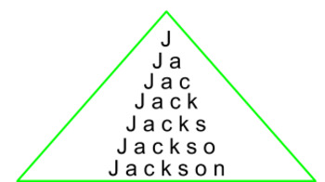

Slide 3
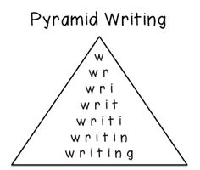

Slide 4
Home work !
Vocabulary word pyramid (or tree)

Slide 5
g go t to t th the c co con conc conce concer concert
g go t to t th the m
mo
mov
movi
movie
movies
s
su
sur
surf
t
th
the
i
in
int
inte
inter
Intern
interne
internet
g go b
bo
bow
bowl
bowli
bowlin
bowling
p
pl
pla
play
o
on
onl
onli
onlin
online
g
ga
gam
game
games
t
ta
tak
take
a
t
tr
tri
trip

